Slide 1

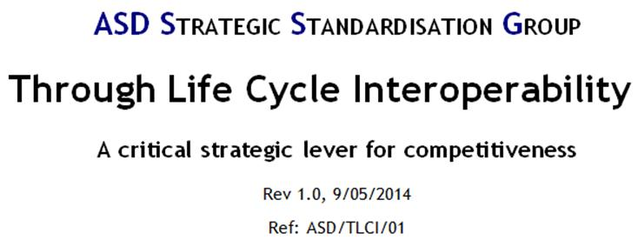
ASD SSG “Through Life Cycle interoperability” report
A critical strategic lever for competitiveness
The objective of this document is to develop a vision of
Through Life Cycle Interoperability for Aerospace & Defence
and to propose recommendations.
Table of content
1. Introduction
2. The interoperability challenge
3. Status of interoperability standards
4. Required standards architecture
4.1 Global requirement
4.2 Interoperability Framework
4.3 Envisioned standards backbone
4.4 Proposed recommendations
Executive Summary:
- Vision
- The business challenge
- Benefits
- ASD SSG answer
Approach:
1. Identify the business requirements for A&D digital information interoperability, and analyze gaps with existing standards and practices,
2. Identify a set of coherent standards to use or to develop in order to cover the full spectrum of needs for interoperability,
3. Propose and apply governance tools at strategic and technical level (e.g. radar screen, interoperability framework, assessment process),
4. Develop a network of experts,
5. Develop liaisons with all relevant standardization organizations,
6. Identify and communicate the business benefits,
7. Seek the widest exploitation of these standards to maximise global benefits.
Download the report
on ASD SSG web site
1

Slide 2
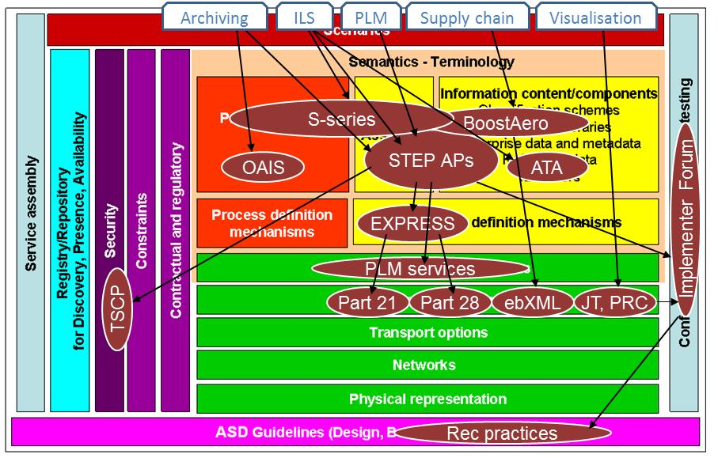
Proposed recommendations
ASD SSG “Through Life Cycle interoperability” report
A critical strategic lever for competitiveness
1. Strengthen the STEP architecture approach to 1) ensure interoperability between STEP standards and 2) provide unambiguous implementation methods (including for new information technologies, e.g. OSLC).
2. Ensure that 3D visualisation format standards used in the industry are consistent with STEP standards
3. Ensure the common data model for the ILS specifications is consistent with STEP AP239.
4. Promote the ASD-AIA ILS suite of specifications and seek to manage coherence with ATA specifications where needed by the industry.
5. Participate in the development, and interoperability testing of the next generation of PDM/PLM web services.
6. Facilitate data interoperability in the Aerospace and Defence Supply Chain and align business process between Supply Chain stakeholders.
7. Supports the setting-up of implementer forums (e.g. PDM implementer forum) to test and validate the implementation of the standards-based solutions.

