Slide 1

Continuité Numérique : un enjeu d’efficacité pour l’industrie supporté par les standards
Standard STEP AP 242 – ISO 10303 :
modèles CAO 3D avec tolérancement gérés en configuration
Principaux besoins de l’industrie aéronautique
Le 26 mars 2014,
Centre de conférence Paris Trocadero
Amaury SOUBEYRAN, Airbus Group HQ

Slide 2
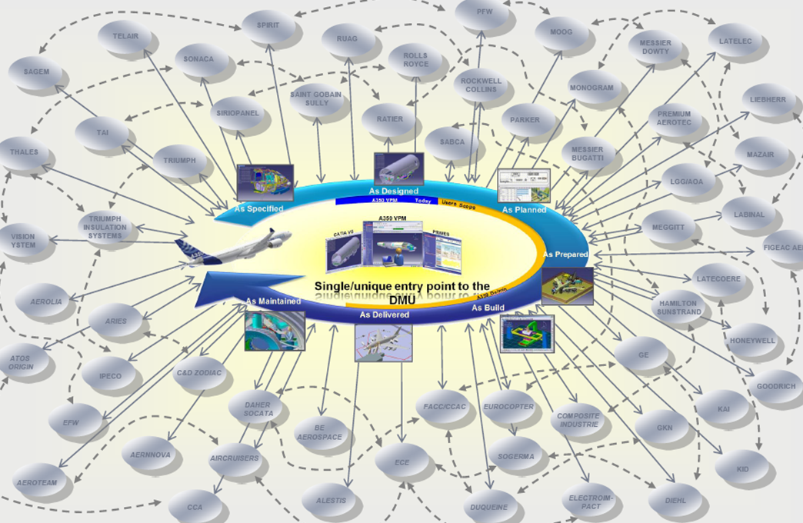
The Aeronautic Extended Enterprise challenge
Customers evolving context and pressure for Risk & Cost sharing leads to outsourcing 80% or more of the value chain
Partners (Tier 1,…) take over significant responsibilities for the product in all life cycle phases
Tier 1 will subcontract in a deeper supply chain, even more (in numbers) than the OEM
Reliable and cost effective reuse of CAD-PDM information
across multiple stakeholders
interoperability
Standards!
2

Slide 3
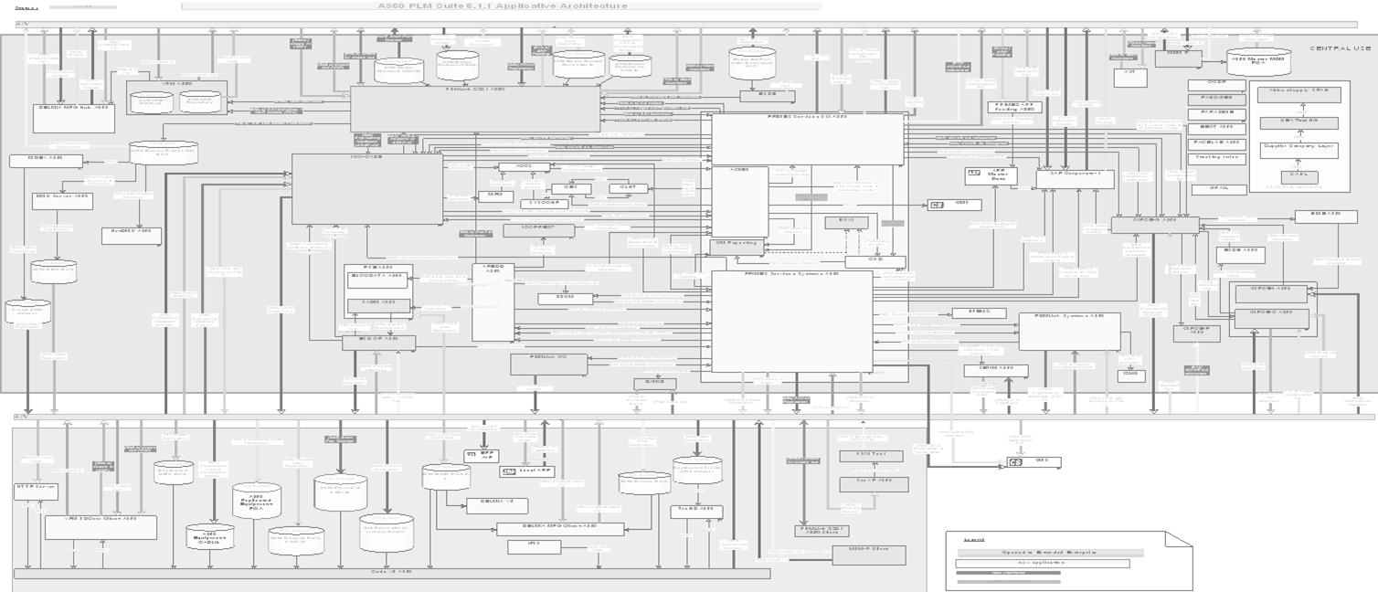


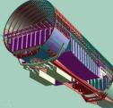
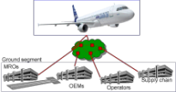
Full life-cycle domains integration challenge and support of the 3D model based design
Concept Development
Design, manufacture & Assembly
Validation & Certification
Operations
« Full virtual rigs » deployed with Testing Labs and Certification authorities
« Full virtual concept » deployed with System contractors and with Disciplines
« Full 3D configured DMU» deployed with component and sub-assembly Suppliers
« Full virtual A/C enabled services » deployed with Operators and MROs
Reliable and cost effective reuse of CAD-PDM information
across multiple domains / multiple tools
interoperability
Standards!

Slide 4






Obsolescence challenge for PLM systems
Life of Operating System
1.5 year
Life of Computer
3 years
Needs of migration
of CAD-PDM information
etc…
Time between CAD versions
0.5 year
Life of CAD system
10 years
Needs of
LT Archiving & Retrieval
of CAD-PDM information
Life of Aerospace product
70 years +
Time in years
10
20
30
40
Reliable and cost effective reuse of CAD-PDM information
along multiple timescales
interoperability
Standards!

Slide 5
Merci pour votre attention

