Slide 1
ASD recommendation related to
Design Reference on a Purchase Order
Samy Scemama
Supply Chain interoperability Working Group

Slide 2
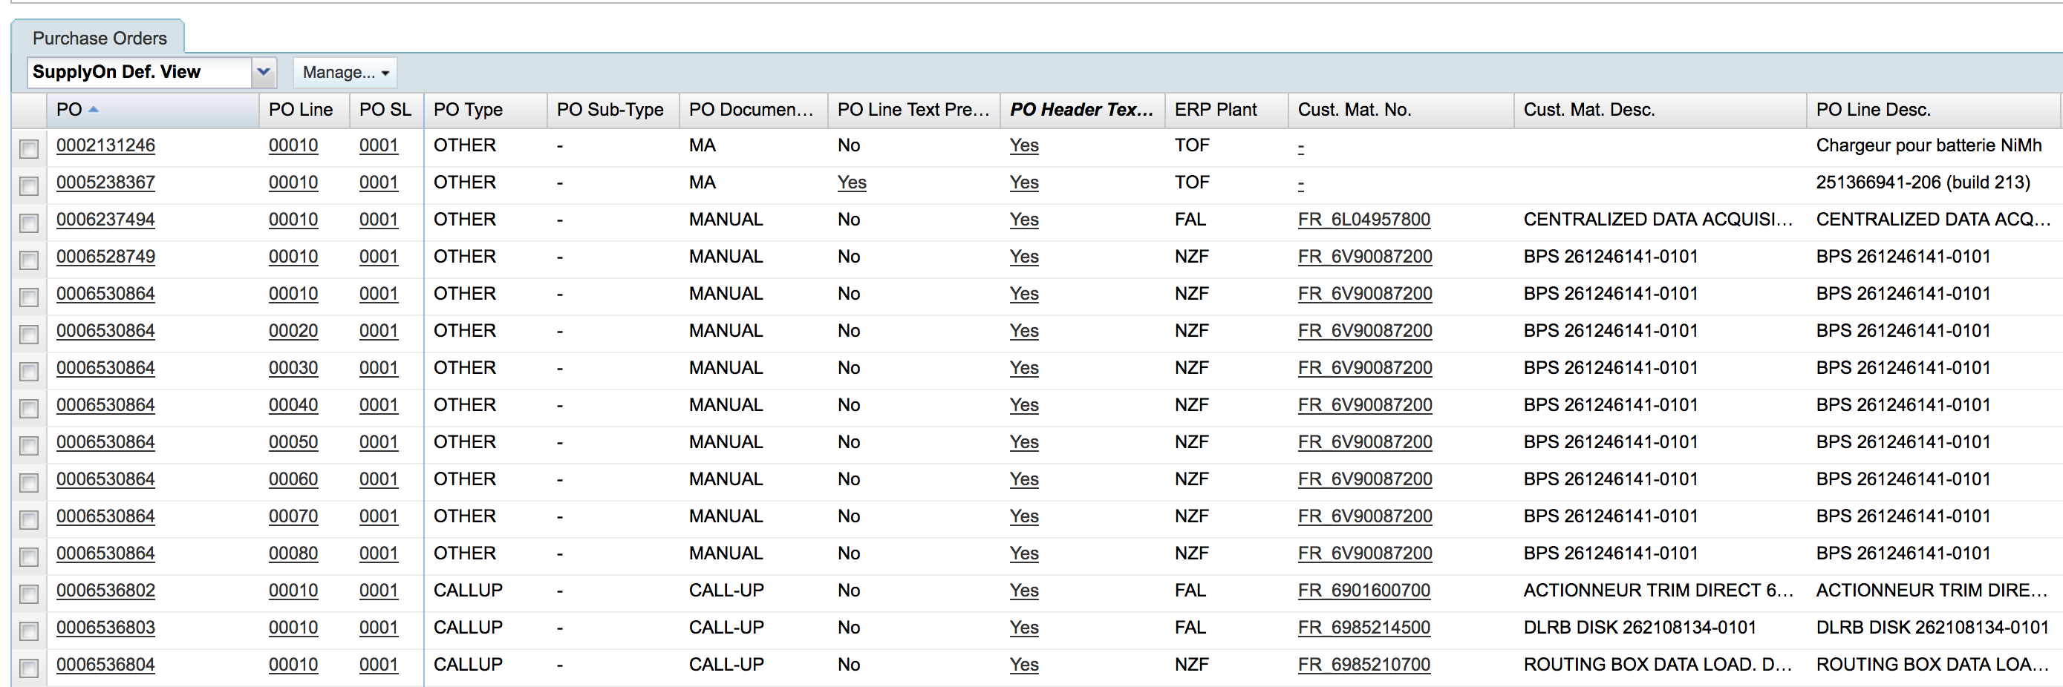
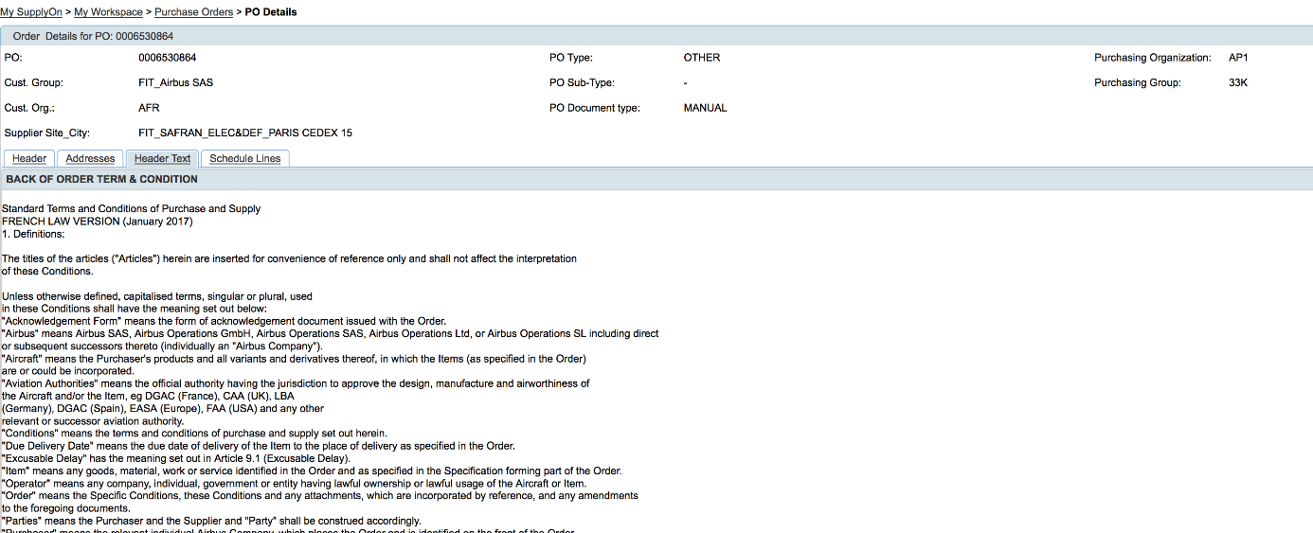
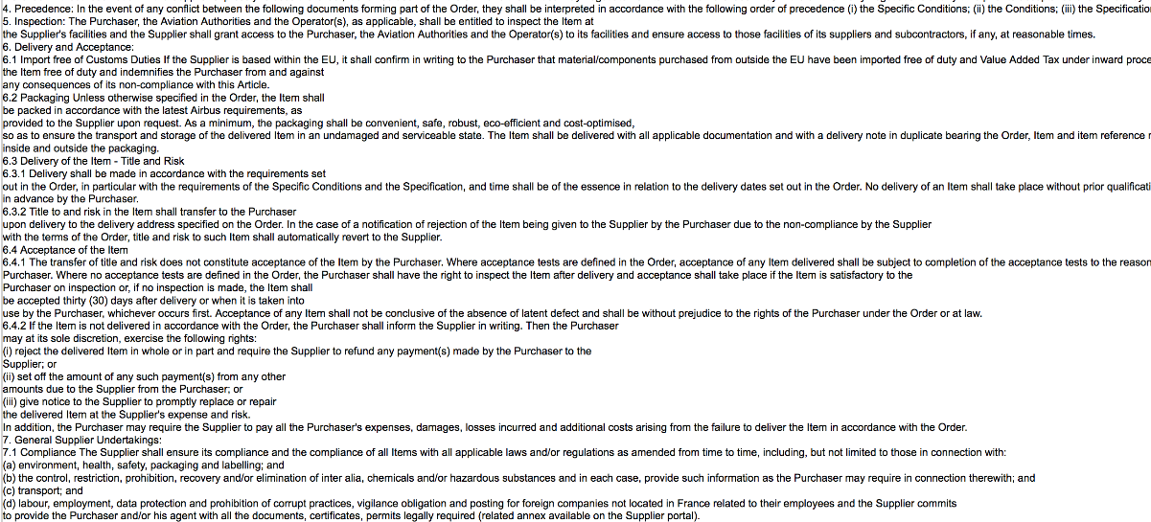
Customers send Purchase Order (PO) on AirSupply or on their Supplier portal.

Slide 3
Use Case: Design Reference on a PO
Current situation on customer side
  Customers sends PO on AirSupply
  When a customer sends a PO, it is important that this PO will include the References of the Design that could include many specification : Drawing specification, Technical Specification, …
  Today, each customer use a specific way to send these Design Reference in a PO
  In general, customer sends these references in the Header Text or Line Text
Current situation on supplier side : Order Review is mandatory for Quality process
  When a supplier receive a PO, it is mandatory to process an Order Review and check : Price, Quantity, Date and cycle, Drawing specification, Technical Specification, …
Problem:
  If a supplier launch its production based on a wrong Design specification, then the product will go to scrap
  It is complex for a supplier to check if the references of the PO are the same than those in its ERP
  As the Design Reference are completely mixed with the other information in the Line Text or Header Text : It is impossible for the supplier to check automatically for each PO (or CallUp) if there is a change of one of the specification
Consequences:
  Waste of time, if change of specification is not detected on supplier side : supplier can launch production of article not requested by the customer

Slide 4
Design Reference on a PO
Proposed solution to solve the problem:
  Customer create an edition on the TDP (Technical Data Package)
  At the Initial Contract phase, the supplier will copy the customer TDP edition in its ERP
  Whenever one or more of the component of the TDP is changing (Drawing Spec, Design Spec, Technical specification, ...) the edition of the TDP is incremented by the customer and its sent to the supplier
  Each time, the supplier is receiving an evolution of a document constituting the DESIGN shall contain the evolution of the TDP, via the customer Design people, the supplier will copy the edition of the TDP in its ERP
  This will make it easy for the vendor and the Sales Administration people to find out if there is a difference between the edition of the TDP that is in its ERP and the edition of the TDP that is on the PO sent by its customer on AirSupply.
  Automatic comparison of the edition of the TDP are also possible.

Slide 5
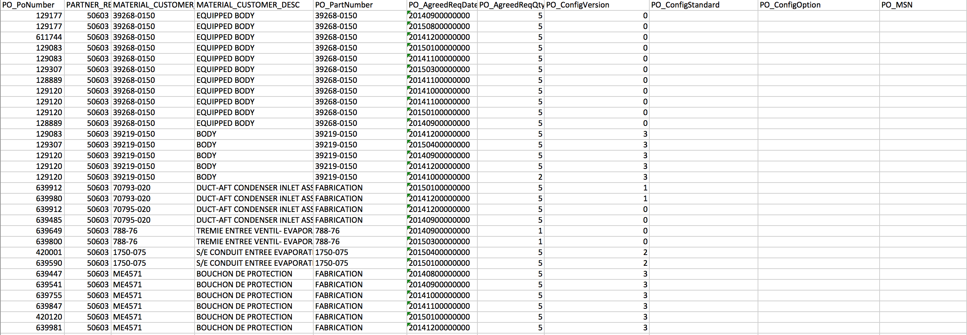
Field that could be used on AirSupply for the edition of the TDP (PO): PO_ConfigVersion
AirSupply field | User Interface | BoostAero |  |  |  | Definition
ConfigurationVersion | PO_ConfigVersion | CIPO_ Supply Chain_ Trade Transaction. Included. CIPOL_ Supply Chain_ Trade Line Item (0,*) | CIPOL_ Supply Chain_ Trade Line Item. Specified. CIPOL_ Supply Chain_ Trade Agreement (0,*) | CIPOL_ Supply Chain_ Trade Agreement. Specified. CI_ Mission_ Project (0,*) | CI_ Mission_ Project. Identification. Identifier (0,*) | A mission project specified for this supply chain trade agreement
edition of the TDP
AirSupply User Interface:

Slide 6
ASD recommendation
To highlight any change in the specification or Technical Data Package (TDP) associated to a Purchase Order, SSG recommend the following Implementation convention:
  The principle is to create an “edition” on the TDP that will evolve each time one or more component of the TDP is changed.
  This information will be displayed on AirSupply in a field to be defined by BoostAeroSpace founders, for example:
AirSupply field | User Interface
ConfigurationVersion | PO_ConfigVersion

