Slide 1
ISO STEP AP242
“Managed Model Based 3D Engineering”
Roadmap for T-Systems STEP applications
Paris, the 26th of March 2014

Slide 2
AP242 Roadmap
Applications
  T-Systems applications supporting STEP AP242
  PDM WebConnector V3.8 SOA-based middleware for PDM system integration
  COM/PDM V1.1 STEP based PDM data exchange for supplier integration
  COM/FOX V5.5.2 CAx data conversion platform
  Supported AP242 Release
  AP242 BO Model XML (IS Review)

Slide 3
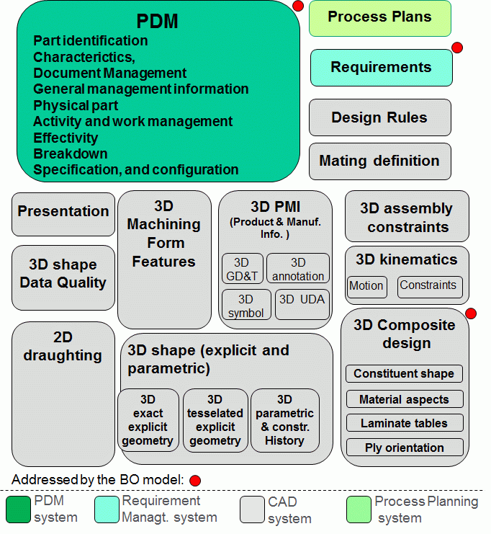
AP242 Roadmap
Capabilities Overview

Slide 4
AP242 Roadmap
Capabilities covered by PDM WebConnector and COM/PDM
  PDM data
  Assembly structure
  Configuration management
  Change management
  Using AP242 BO Model XML
  as data exchange format

Slide 5
AP242 Roadmap
Capabilities covered by COM/FOX
  Focus on CAD mechanical data + assembly structure + visualization
  Using AP242 BO Model XML
  as data exchange format for assembly structure + kinematics
  Using JT for geometry and PMI
  Using PLM XML for motion data
  from/to CATIA V5

Slide 6
AP242 Roadmap
Availability
Product | Version | AP242 BO Model Rel. | Capabilities | Availability
COM/FOX | V5.5.2 | IS Review | Assembly structure Nested Assembly Kinematics (Prototype) | March 7, 2014
 | V5.5.x | IS | Assembly structure Nested Assembly Kinematics (Product) | Summer 2014
COM/PDM for: Aras Innovator Teamcenter UA Windchill Enovia | V1.1 V9.4, V10 V9.x, V10.1x V8.x, V9.x, V10.x VPM V4, V6 | IS | General Mgnt Info. Assembly structure Document Mgnt. Configuration Mgnt. | Fall 2014
PDM WebConnector | V3.8 | IS | General Mgnt Info. Assembly structure Document Mgnt. Change Mgnt. Configuration Mgnt. | End of 2014

Slide 7
AP242 Roadmap
Covered Use Cases 1/2
Customer
Business
Process
PDM WebConnector
  Web Client
  Rich Client
  Portal
External Clients
Teamcenter
Services
Process
Services
Composed
Services
Data
ENOVIA
Flexibility - Interoperability - Loose Coupling
  Exalead (Cloud View,,
  One Part)
Enterprise
Search Engines
Monitoring
Access
Performance
Operation
Load
Aras
  COM/PDM
  (COM/TC, COM/WT, COM/ARAS)
Collaboration
Tools
Use Cases
Windchill
Multi-disciplinary Integration
Process automation and monitoring
PLM System Synchronization including Multisite
PLM System Migration & Co-existence
Secure Online & offline Collaboration
  3D Printing
  CAD Conversion
  Management Cockpit
Printing
&
Conversion
SAP
Formats & Standards
STEP AP214 ARM/AIM
STEP AP242 BO Model
OMG PLM Services XML
JT, CATIA V4, V5, V6
Office, PDF, 3D PDF
Connectivity
Modules
Mainframe
Delmia
CATIA V5
Legacy Systems
Individual Systems

Slide 8
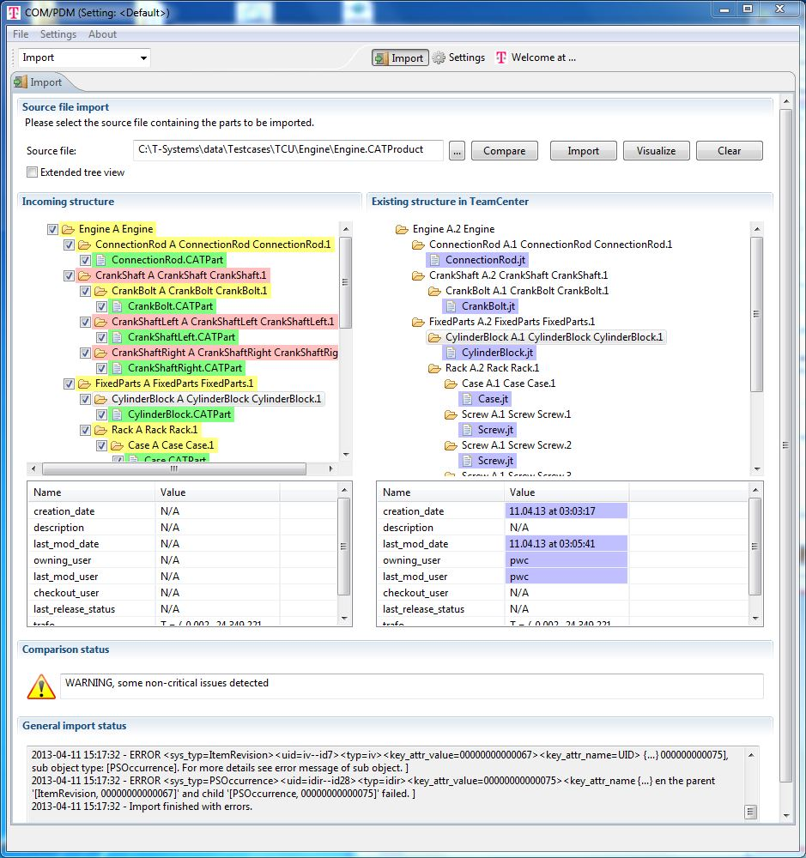
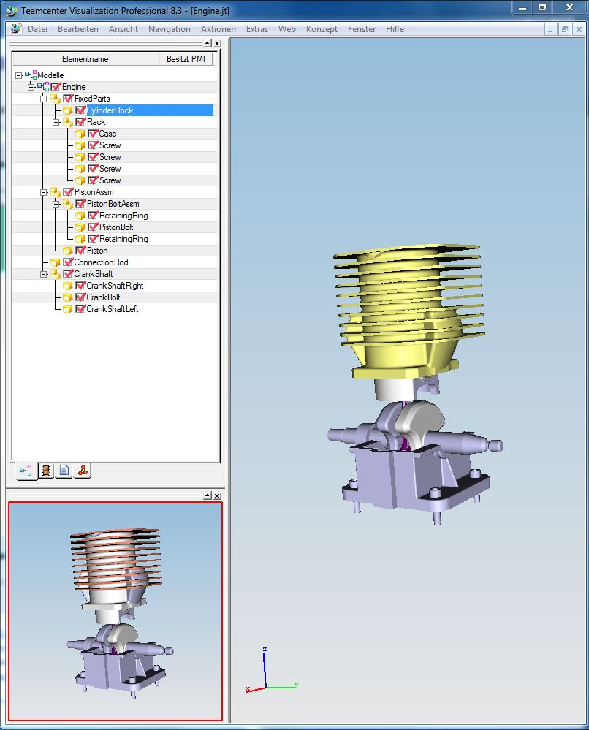
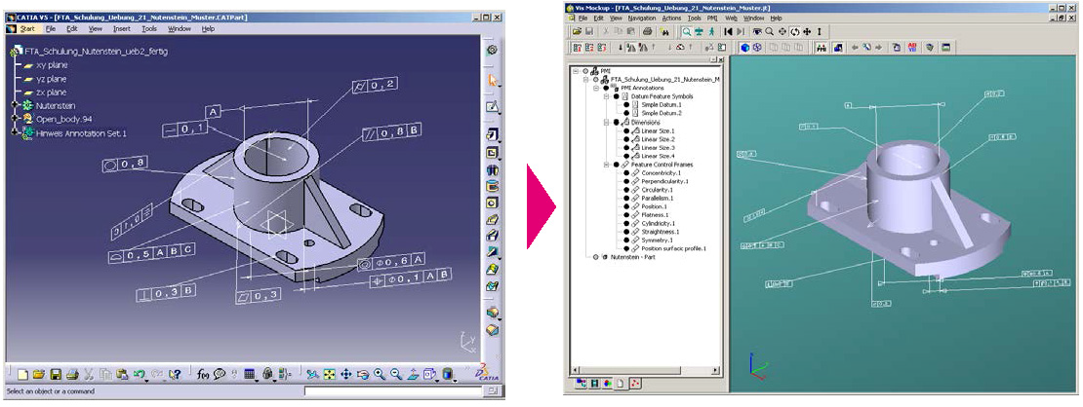
AP242 Roadmap
Covered Use Cases 2/2
  COM/PDM
  Asynchronous STEP data exchange for
  Supplier integration
  from/to Teamcenter UA, Windchill, Enovia VPM and Aras Innovator
  COM/FOX
  CAx data migration
  (system A ⬄ system B)
  CAx data conversion for visualization and
  Virtual Reality (VR)
  Internally between departments/applications or
  externally with suppliers/partners

Slide 9
THANK YOU!
Your contacts:
COM/FOX: Winfried.Weber@T-Systems.com
COM/PDM: Guillaume.Hirel@T-Systems.com
PDM WebConnector: Svilen.Georgiev@T-Systems.com
AP242 Steering Committee Member
+ PLM product Delivery Mgmt: Juergen.Mohrmann@T-Systems.com

Slide 10
ISO STEP AP242
“Managed Model Based 3D Engineering”
Demonstration
Paris, the 26th of March 2014

Slide 11
AP242 Roadmap
Capabilities covered by COM/FOX
  Focus on CAD mechanical data + assembly structure + visualization
  Using AP242 BO Model XML
  as data exchange format for assembly structure + kinematics
  Using JT for geometry and PMI
  Using PLM XML for motion data
  from/to CATIA V5

Slide 12
AP242 Roadmap
Demonstration COM/FOX (‘Primary JT’ at Daimler)
Company
Design Partner
Data Consumer
CAD System NX V9
CAD System CATIA V5
AP242 Viewer
Models (geometry, structure,
PMI, kinematics)
Models (geometry, structure,
PMI, kinematics)
Models (geometry, structure,
PMI, kinematics)
STEP AP242 BO Model
STEP AP 242 BO Model
STEP AP 242 BO Model
Data exchange package
Structure + Kinematics
Models, PMI
STEP AP 242
JT

Slide 13
AP242 Roadmap
Capabilities covered by PDM WebConnector and COM/PDM
  PDM data
  Assembly structure
  Configuration management
  Change management
  Using AP242 BO Model XML
  as data exchange format

Slide 14
AP242 Roadmap
Demonstration COM/PDM (Sample OEM-Supplier Scenario)
Imaginary Demonstration Scenario Overview
Company Henry Mayer works together with suppliers Company FormLine and Company TrustDesign to design a new engine
Company Henry Mayer uses Teamcenter (UA)
Company FormLine has chosen Aras Innovator as its PLM system
Company TrustDesign does not have a PDM system and therefore sends the data in CATIA native format
After finishing the design, company Henry Mayer sends the engine assembly to FormLine in order for them to have the latest version.
FormLine receives the assembly package, inspects it and imports the data into Aras.
Meanwhile Henry Mayer has received a modification from TrustDesign, which TrustDesign would like to be considered in the assembly.
The designer at Henry Mayer opens this package and checks its contents incl. the geometry files to decide, if the modification should be imported or not.

